Slide 1
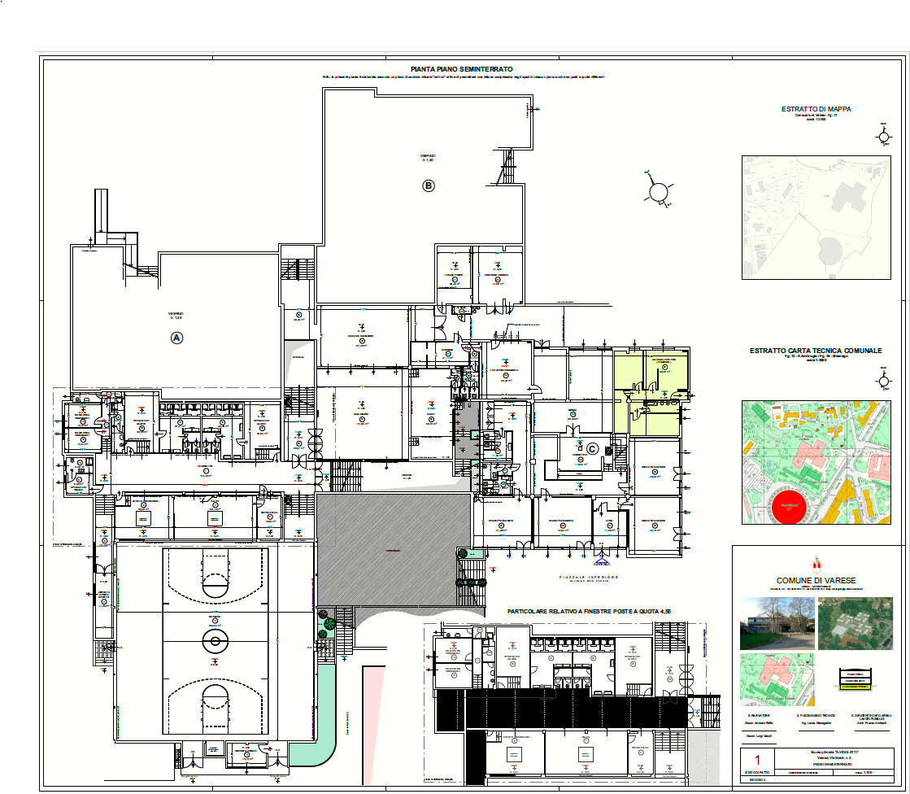
3E
2H-1A-1D

